Slide 1

Petroleum Company System Survey Report
Ali Ehab Ali Hassan 21100800
Mohamed Ashraf Rabie 21100854
Ramez Mohamed Fathi Ahmed 21100793
Youssef Khaled Abdelsalam Mohamed 21100865
Mohamed Ashraf Mahmoud Mohamed 21100873

Slide 2
Petroleum Company System Survey
This survey is done to measure the Importance of each functionality the system will provide for each profession in the company.
The Surveys Link: https://docs.google.com/forms/d/e/1FAIpQLSeZayFwFeDBg33EHD_dfYVA1mLAJDqf0jEphTtsYL_s3GEhyg/viewform

Slide 3
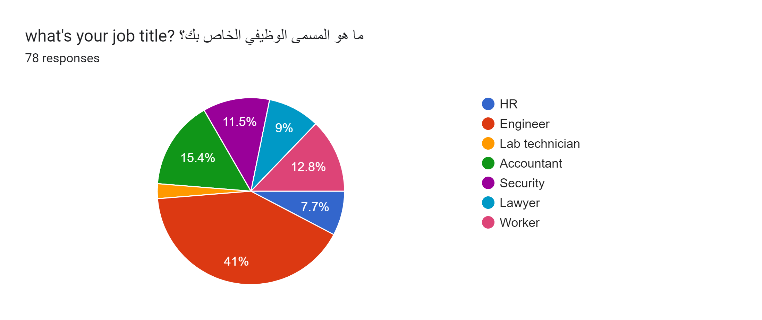
The Participants

Slide 4
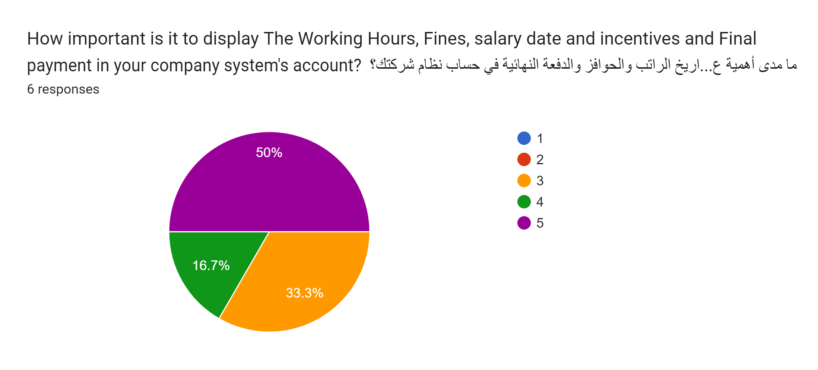
HR: Q1
With 50% choosing 5, and with the lowest chosen rating being 3. it indicates the importance of this functionality as it allows the HR employee to easily track their salary.

Slide 5
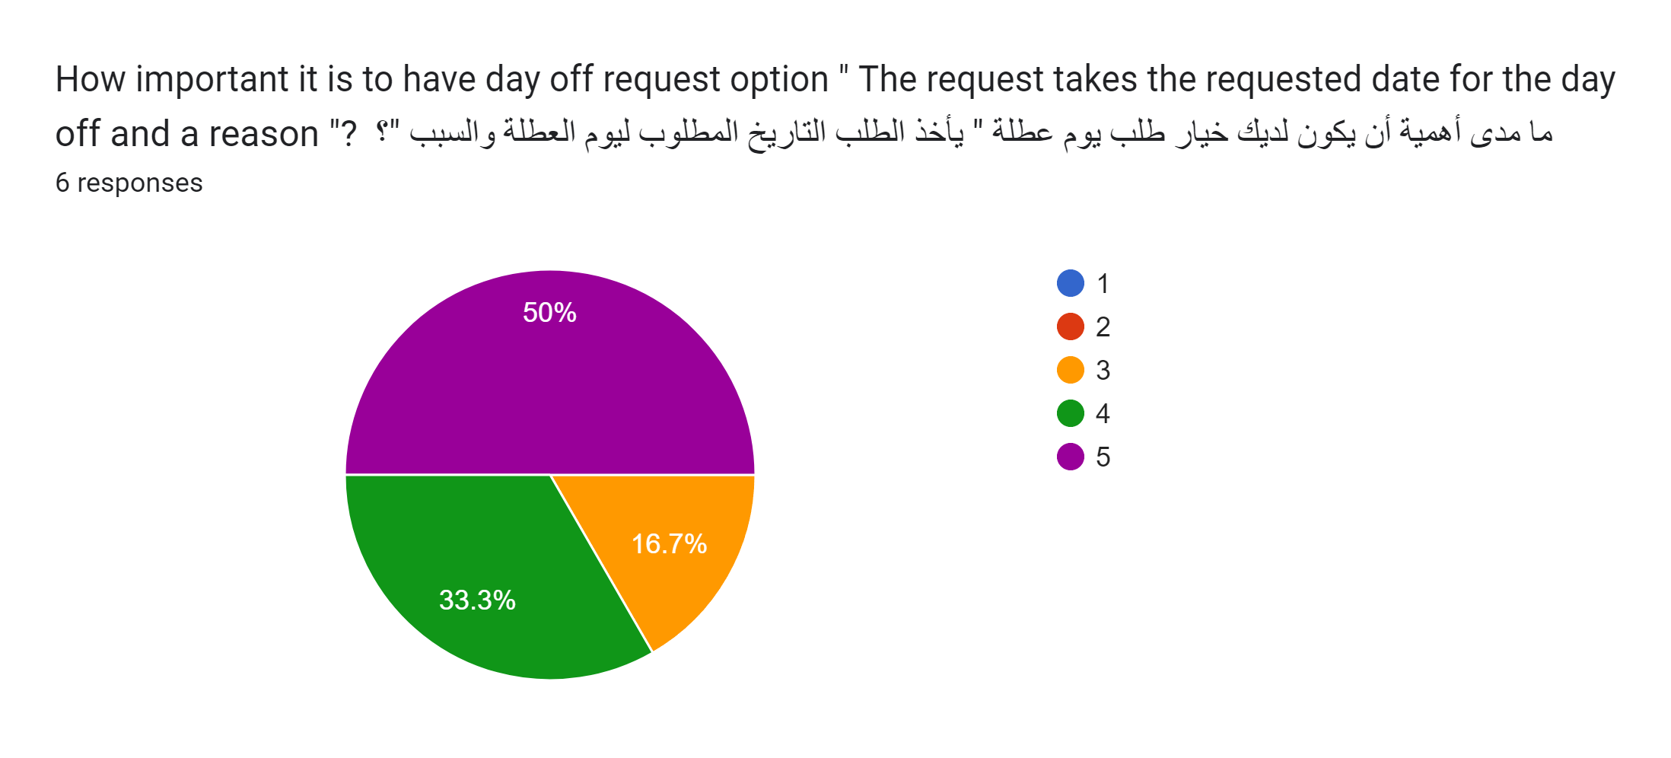
HR: Q2
With the most common answer at 50% being 5. it indicates that the option to easily and remotely ask for a day off request is a quality-of-life option that most HR Employees desire as it removes the embarrassment of going to your superior and asking for a day off.

Slide 6
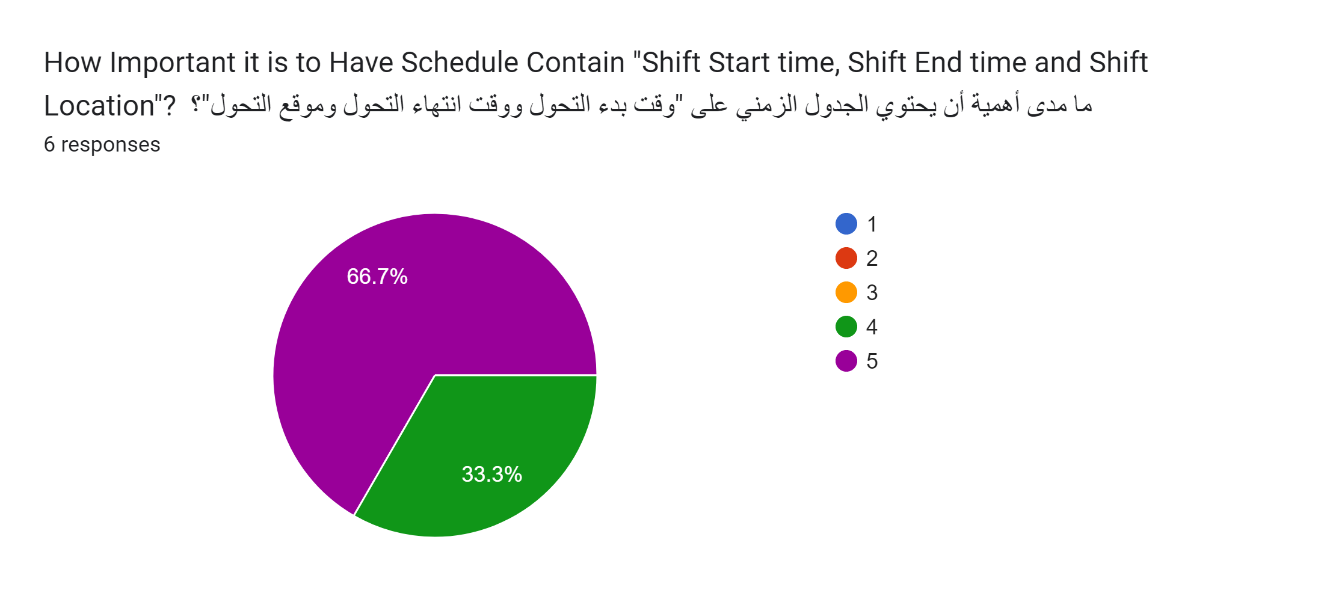
HR: Q3
With an overwhelmingly positive response only containing 4 and 5. it indicates the impotent of this feature as it is the main purpose of this system (Making it easier for the employees to track their Schedule).

Slide 7
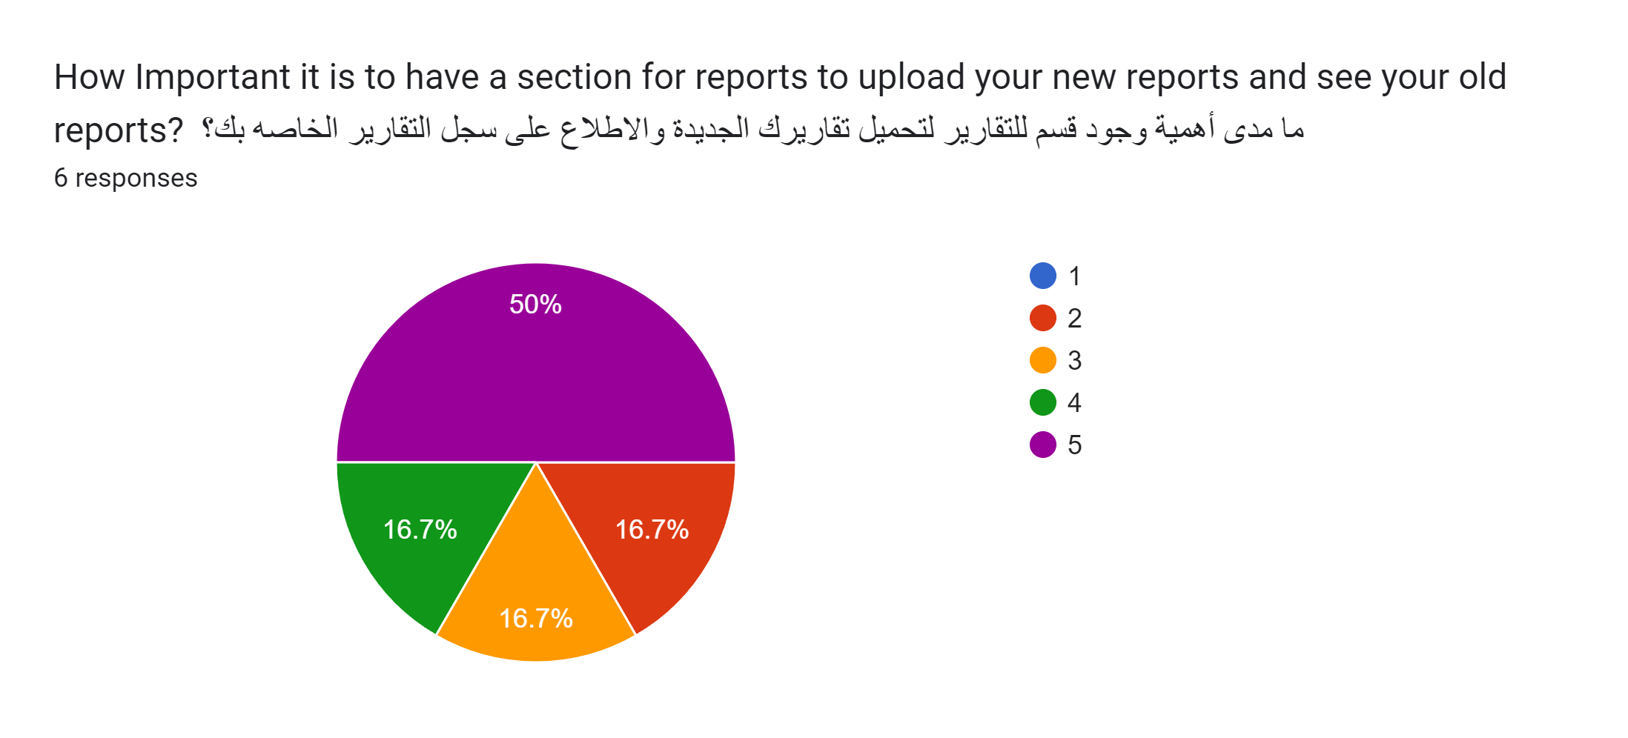
HR: Q4
With most people in favor of this feature it seams that there are some who are not in favor of it probably due to their skepticisms of the security of the data due to its importance or the hassle of turning the reports into required formats and uploading them on the system.

Slide 8
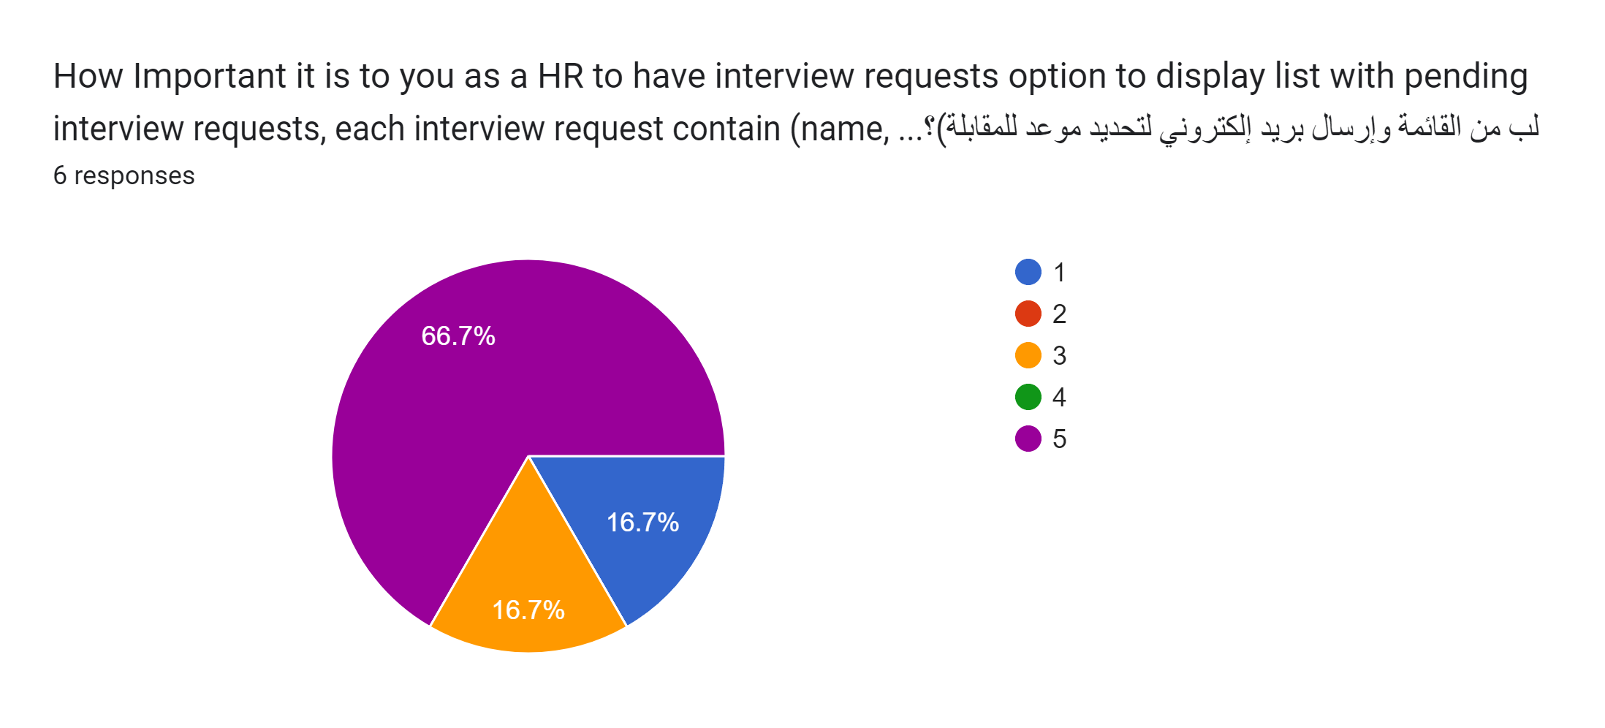
HR: Q5
The high ratings are to be expected as managing the employment is one of the main jobs of the HR employee so having a system that helps automate this would be a welcome addition.

Slide 9
HR Employee Survey Summary
The most important features that the HR employee would use(Managing interviews, Managing their schedule, Displaying a detailed salary report) were met with High scores.
The quality-of-life features(Day off request option) were met with a positive outlook as it removed the embarrassment of the human interaction.
The only Functionality that was met with skepticism was the displaying and uploading report functionality but with a valid reason as the data needs to be highly secure due to its importance.

Slide 10
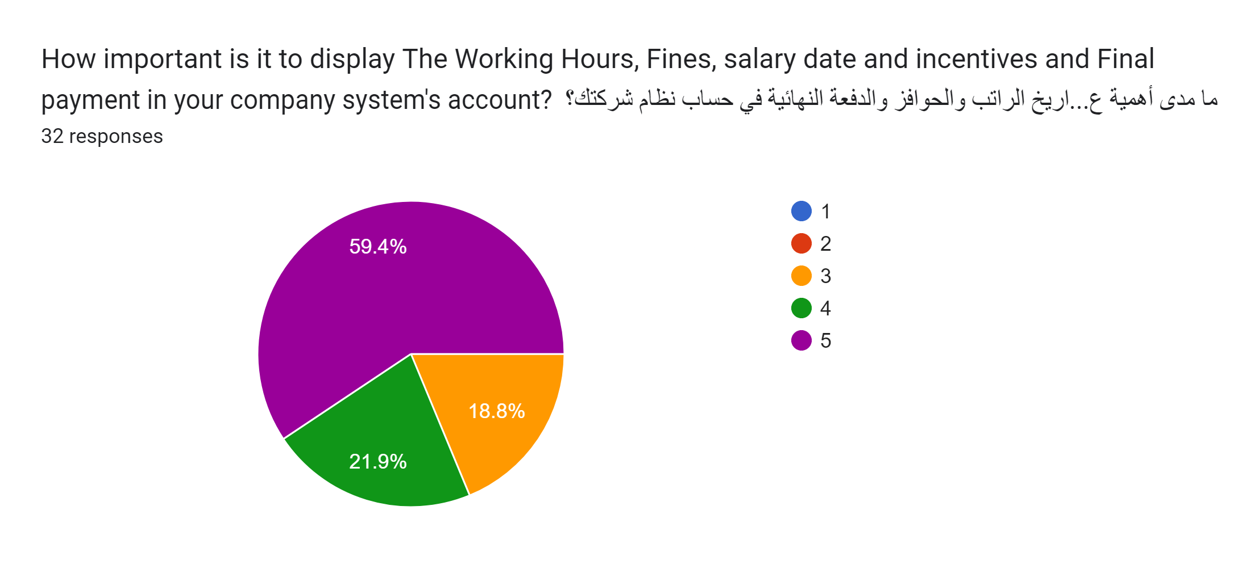
Engineer: Q1
With 60% choosing 5, and with the lowest chosen rating being 3. it indicates the importance of this functionality as it allows the Engineers to easily track their salary.

Slide 11
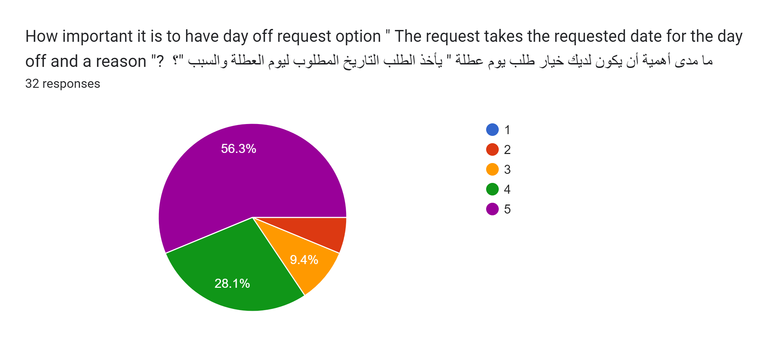
Engineer: Q2
With the most common answer at 56% being 5. it indicates that the option to easily and remotely ask for a day off request is a quality-of-life option that most HR Employees desire as it removes the embarrassment of going to your superior and asking for a day off.

Slide 12
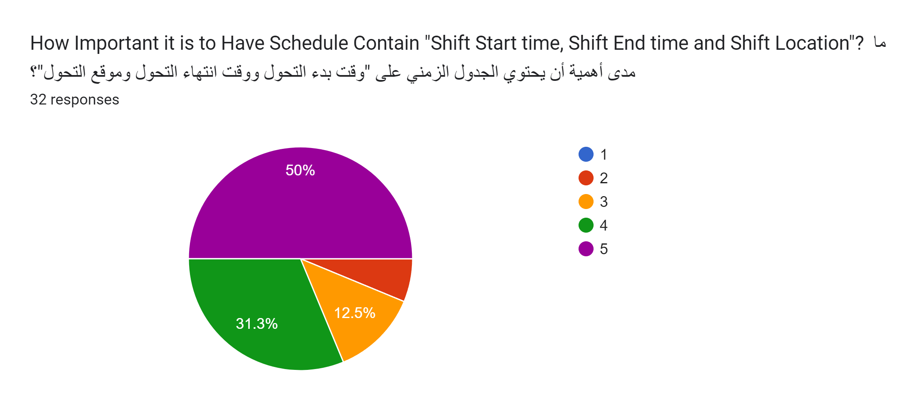
Engineer: Q3
With an overwhelmingly positive response only containing 4 and 5. it indicates the impotent of this feature as it is the main purpose of this system (Making it easier for the employees to track their Schedule).

Slide 13
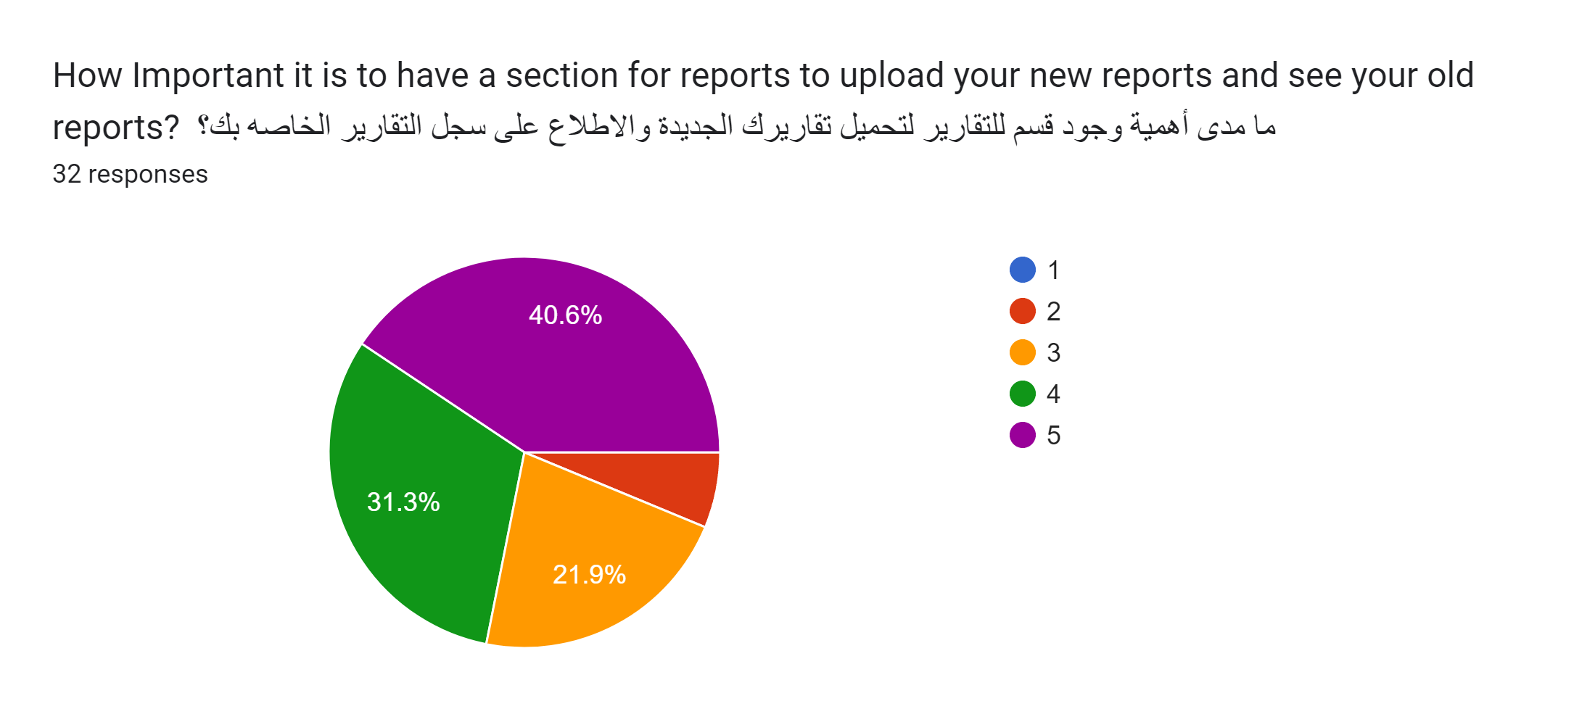
Engineer: Q4
With most people in favor of this feature it seams that there are some who are not in favor of it probably due to their skepticisms of the security of the data due to its importance or the hassle of turning the reports into required formats and uploading them on the system.

Slide 14
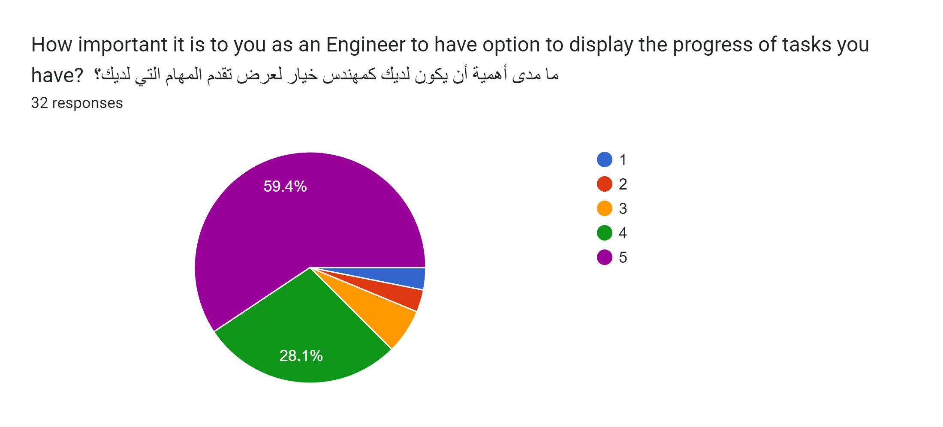
Engineer: Q5
With a majority vote of 60% in favor of this functionality. Displays the importance of this functionality as it will help the Engineers to display their progress in each task they were assigned.

Slide 15
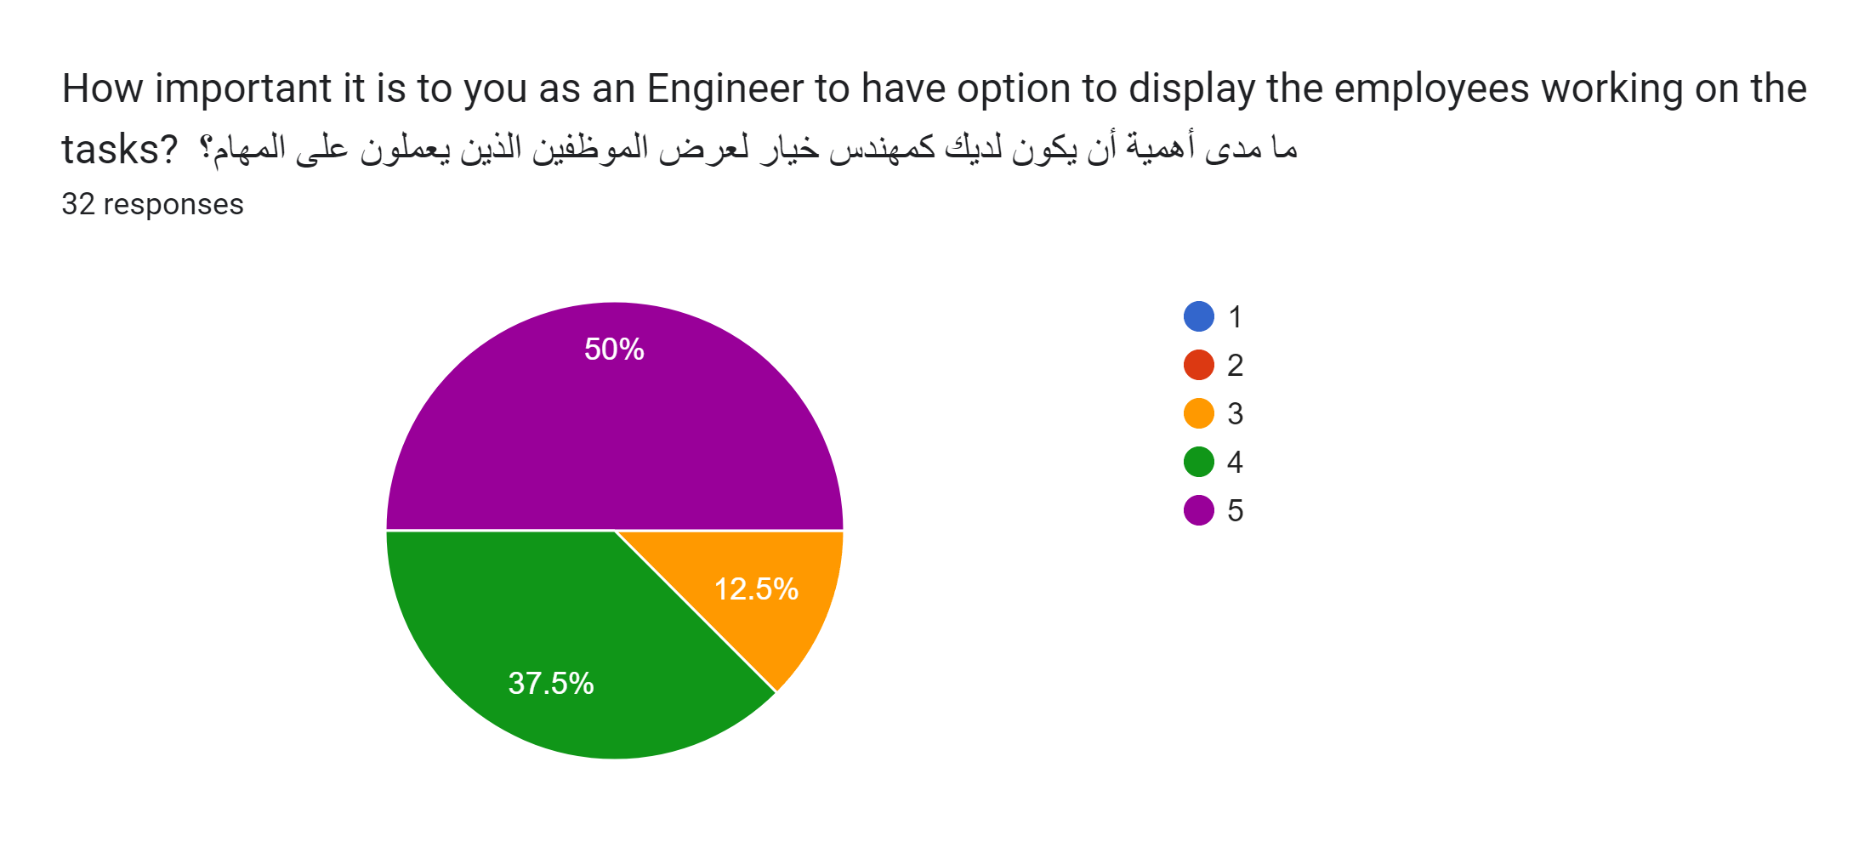
Engineer: Q6
With the majority vote in favor of this function it displays the importance of this functionality as it will help the engineers manage the workers under them.

Slide 16
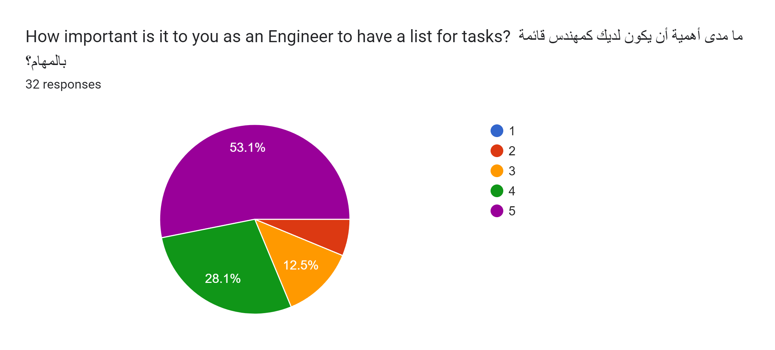
Engineer: Q7
With most of the votes being in favor of this functionality it displays its importance as it will help the engineers to manage their tasks.

Slide 17
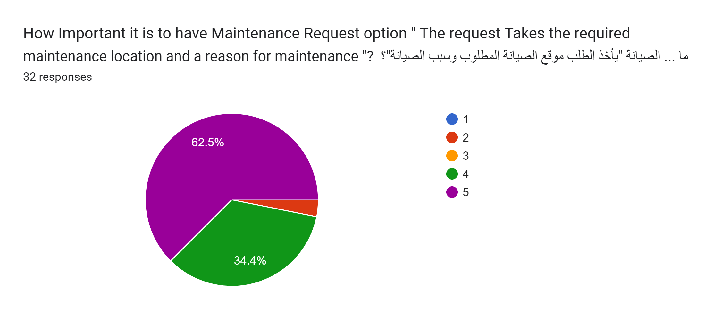
Engineer: Q8
With most votes being in favor of this functionality it displays the usefulness of this functionality as it’s a quality-of-life option making it easier to send requests to fix malfunctioning machinery as replacement and maintenance is required often.

Slide 18
Engineer Survey Summary
With most functionality provided to the engineer being related to scheduling or task management and task distribution it is no surprise that all the functionalities in the survey had an expectedly high score.
the request displaying and uploading was the only functionality with a mix in opinion ranging form a score of 5 to a score of 2 which is to be expected seeing as this is a task that requires high data security due to the importance of the data, so it is no surprise that there is skepticism.
The quality-of-life functions(Maintenance request, Day of request) being met with high favorability seeing as it make embarrassing tasks such as asking for a day off much easier as it no longer requires human interaction, or making annoying but important taskes such as sending maintenance requests easier.

Slide 19
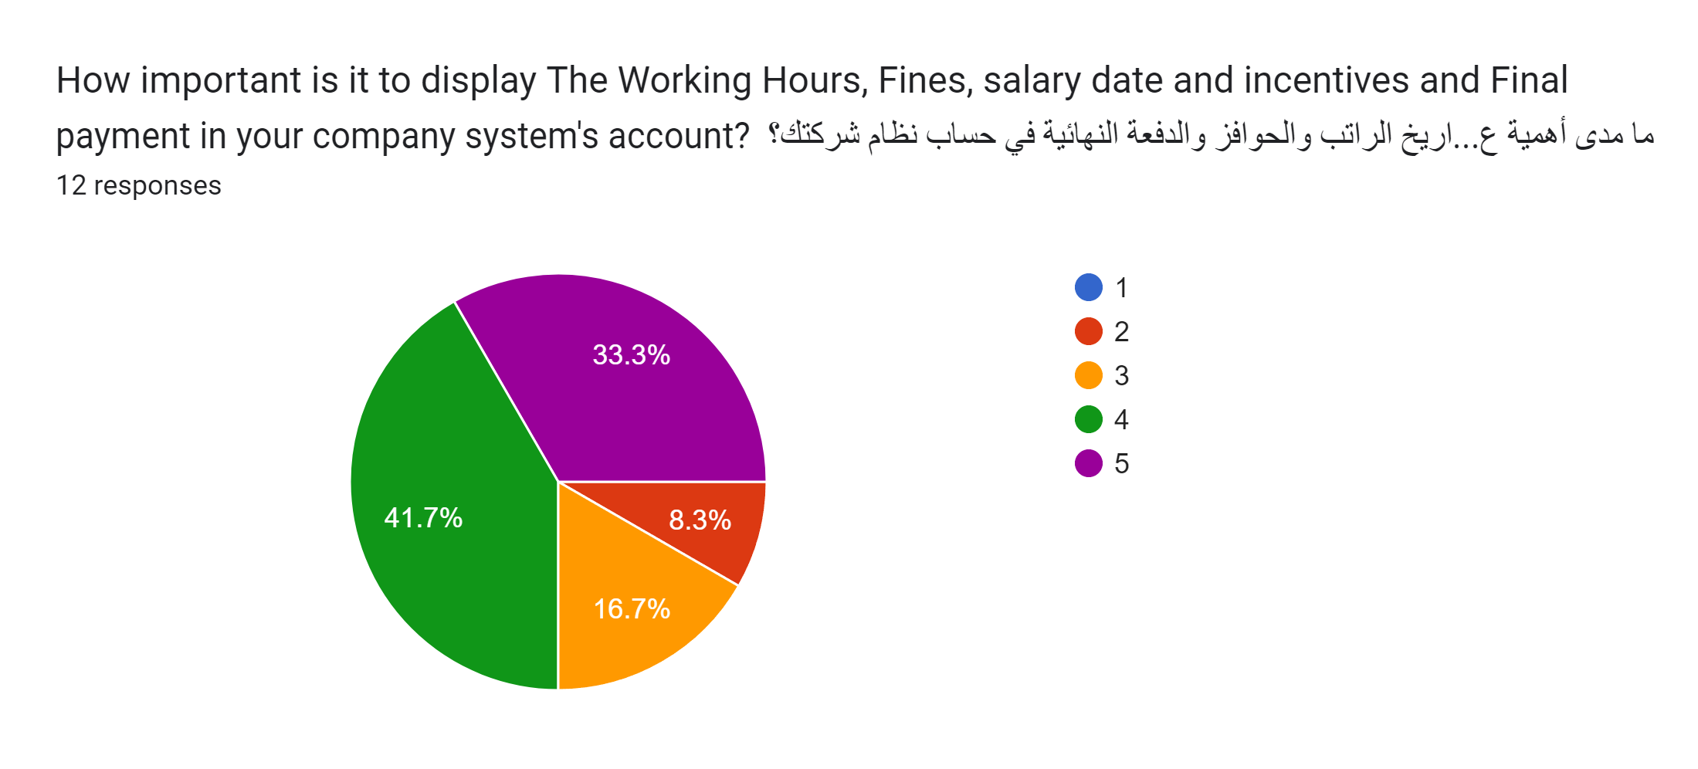
Accountant: Q1
With the majority vote being positive it indicates the importance of this functionality as it helps the employee to trace their finances .

Slide 20
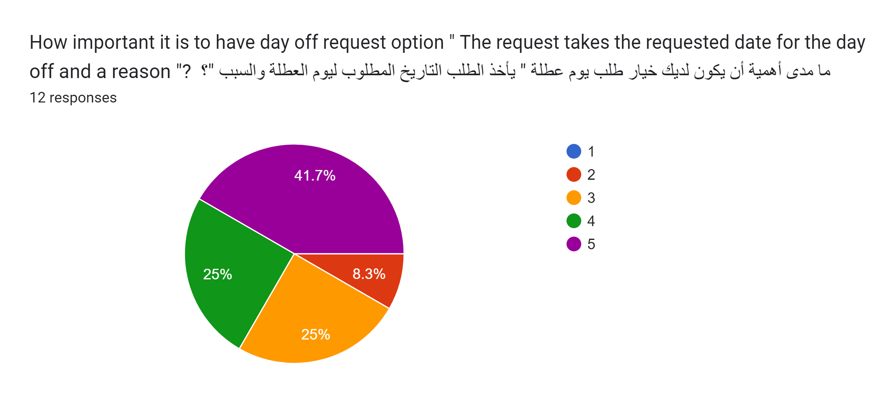
Accountant : Q2
With the majority of the votes being positive. it indicates that the option to easily and remotely ask for a day off request is a quality-of-life option that most HR Employees desire as it removes the embarrassment of going to your superior and asking for a day off.

Slide 21
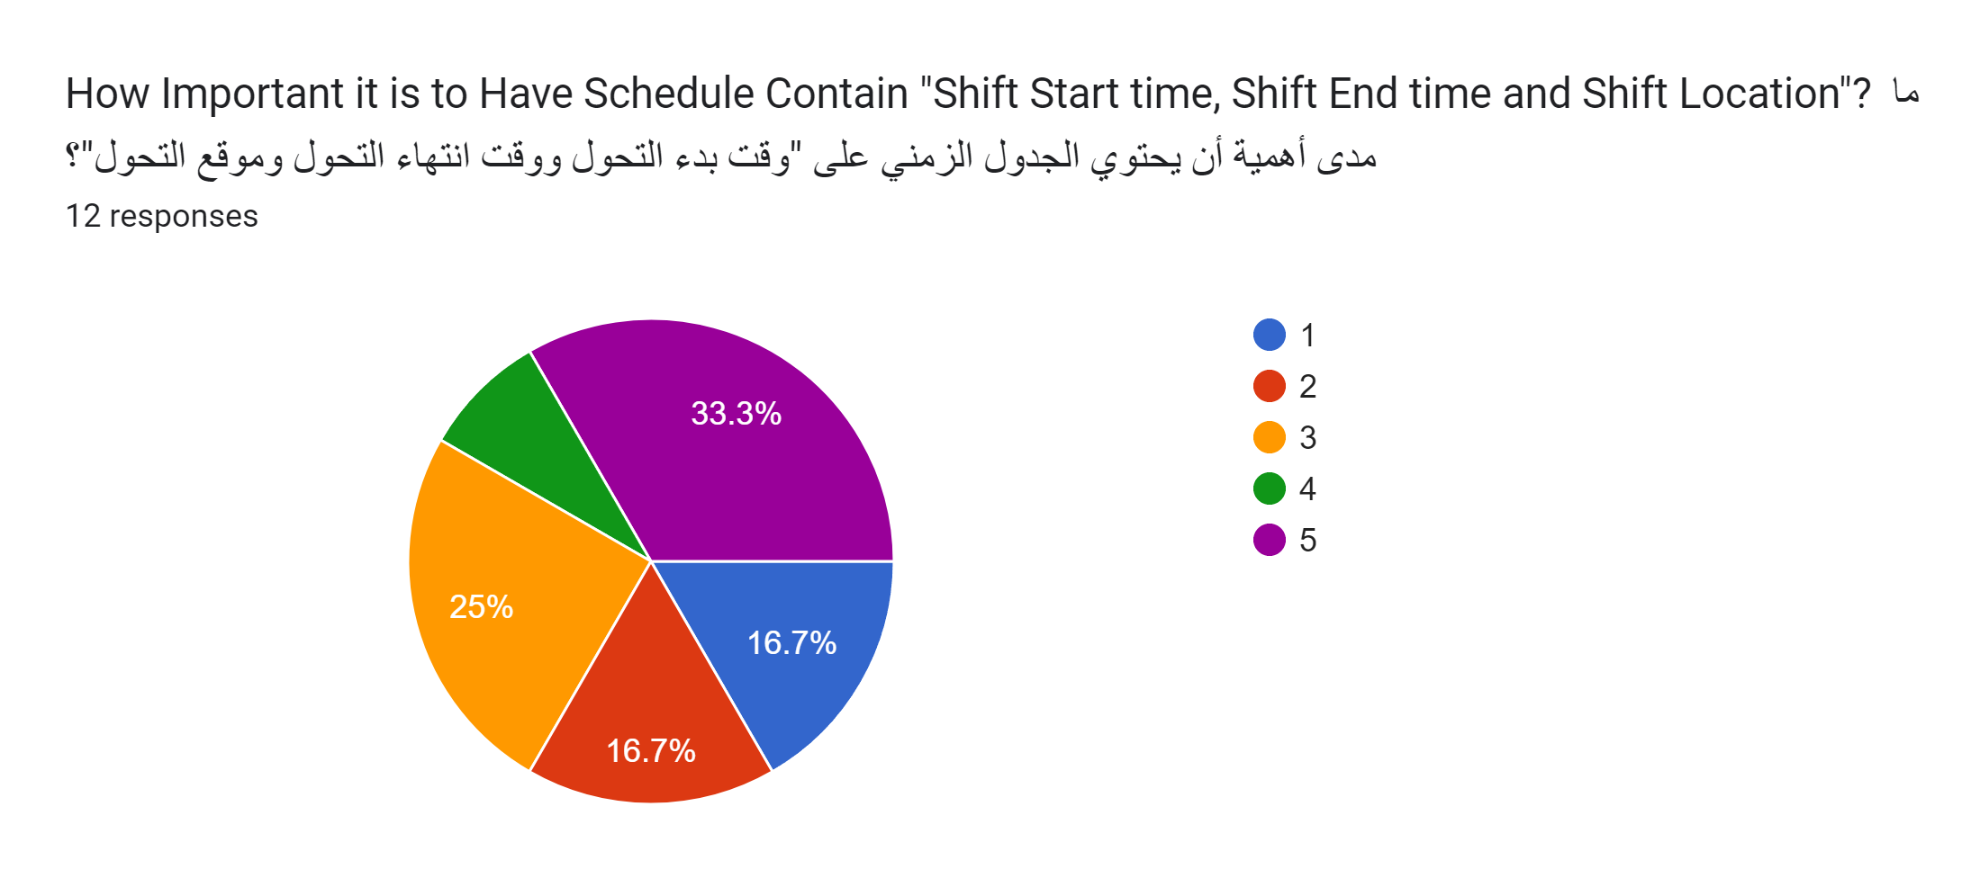
Accountant: Q3
There is a diverse opinion about this functionality as although the majority is in favor of it but that’s by only a small margin that probably being because the accountants have a stable work location with stable working hours making it not really that necessary.

Slide 22
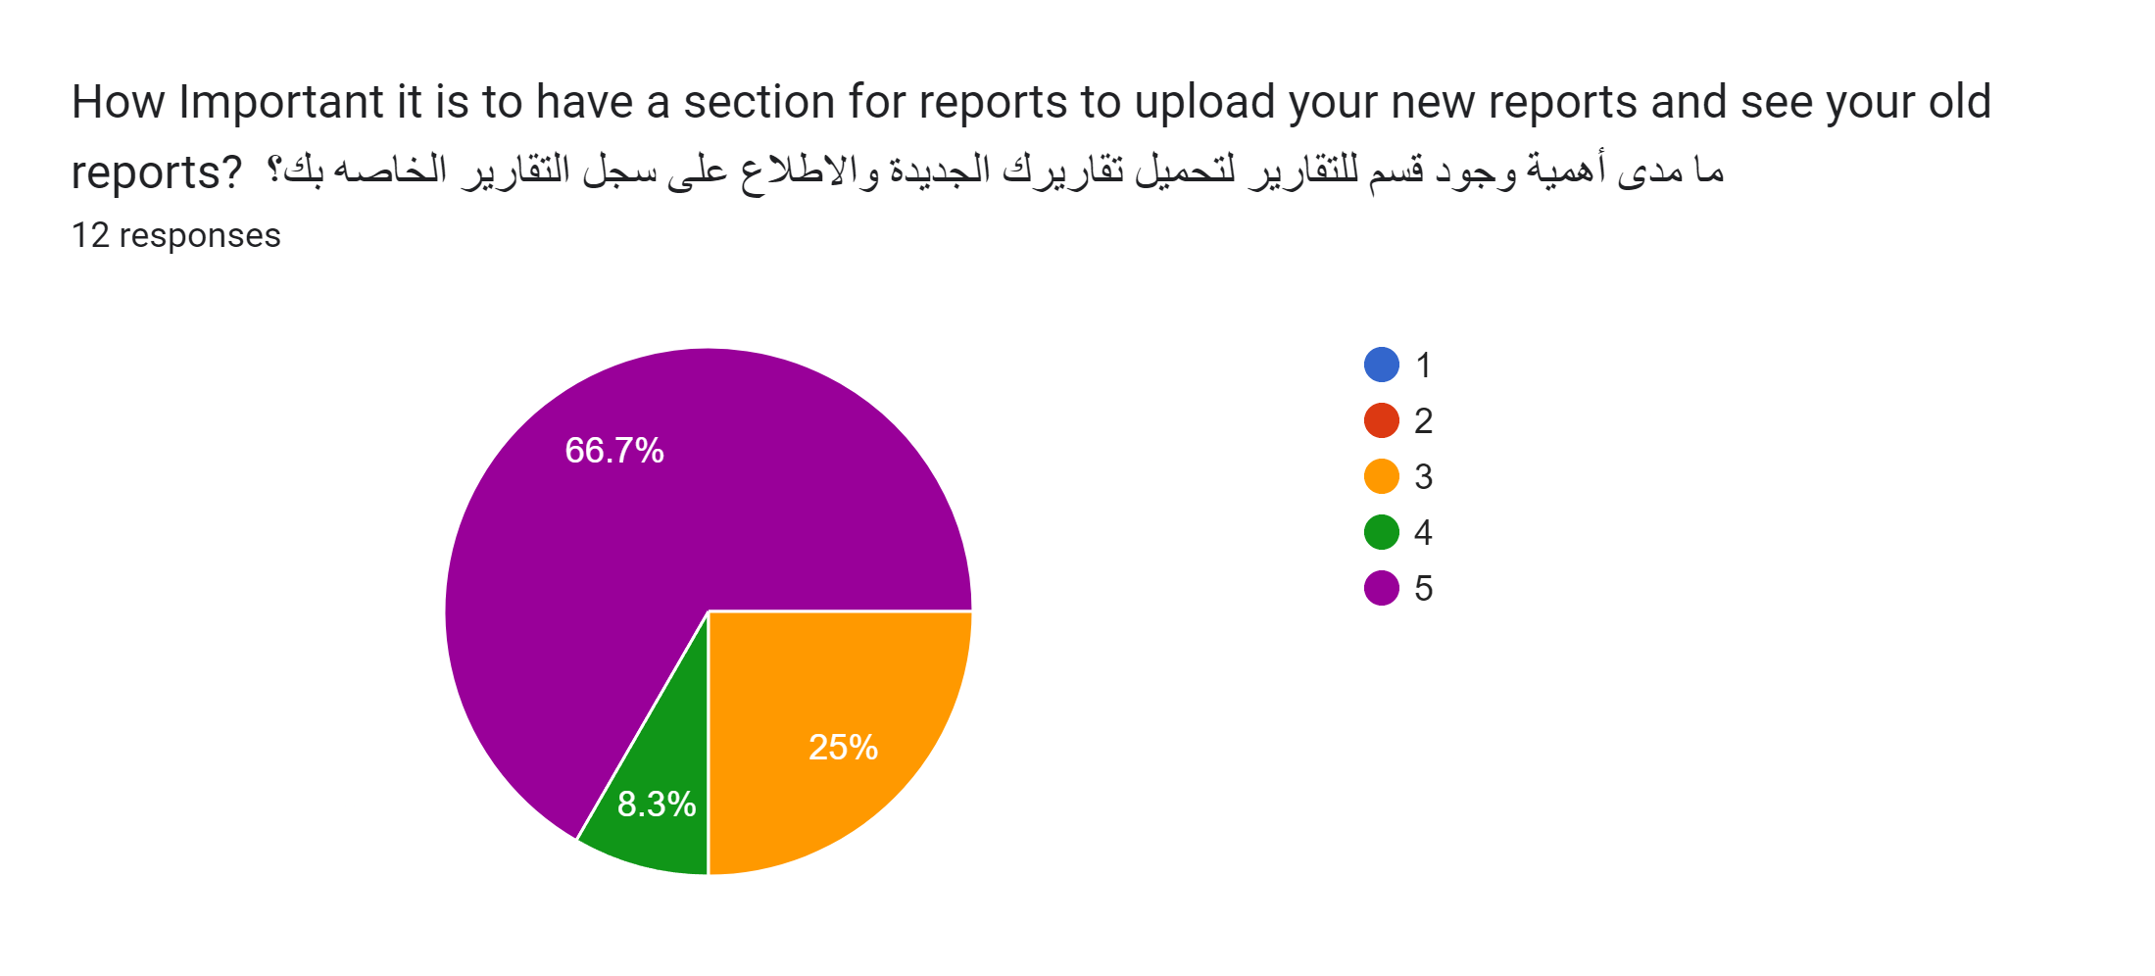
Accountant: Q4
With an overwhelming positive response, it indicates that this feature is necessary probably due to the fact the data changes often and each person keeping track of the data and updating it for all his colleagues on making a change would be a hassle and extremely inefficient.

Slide 23
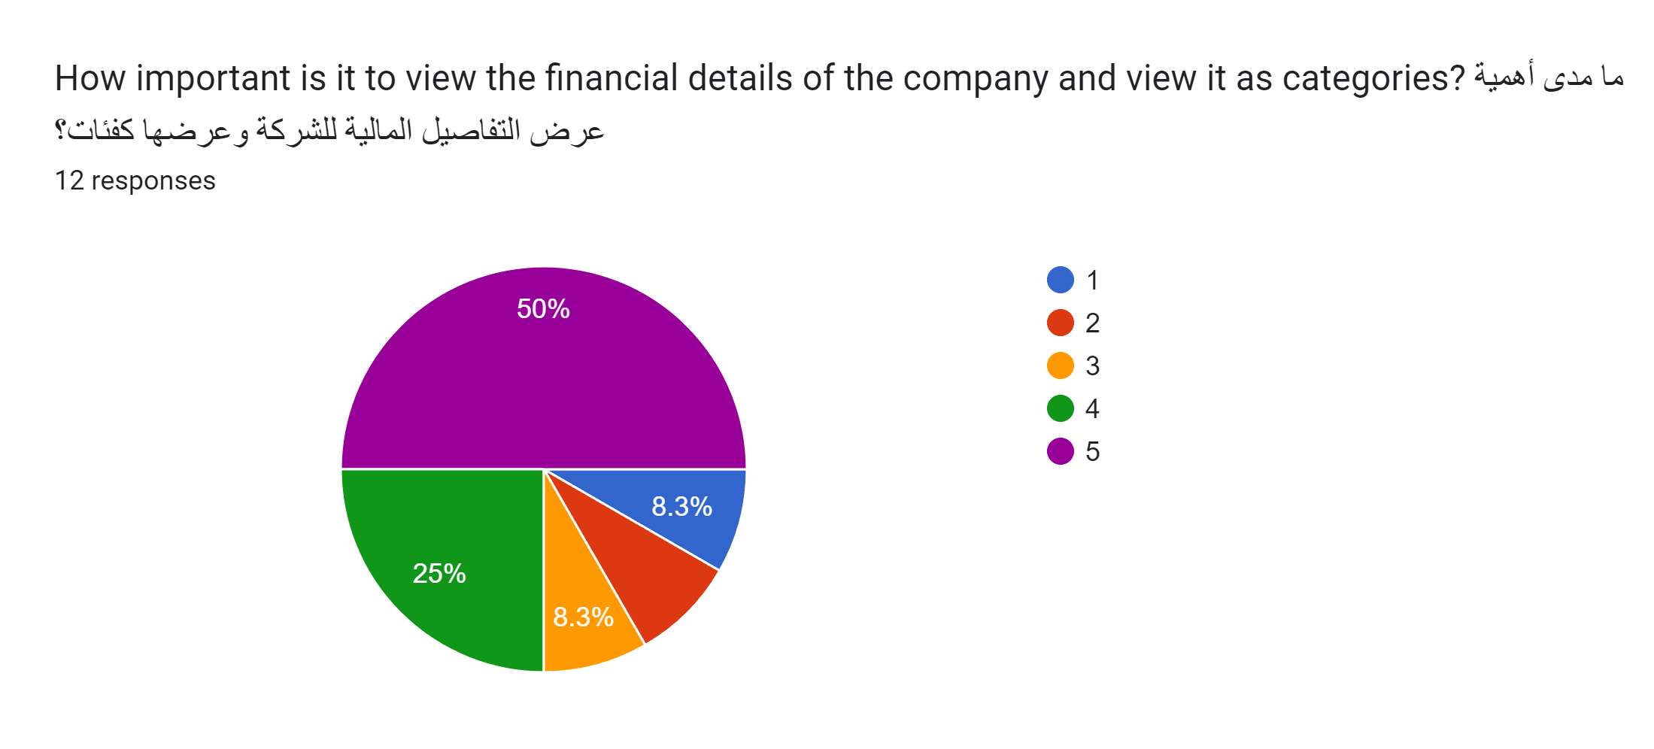
Accountant : Q5
With 75% being positive about this feature because it will make it easier to track the current financial status of the company making their work easier. There are 25% neutral or against this feature probably due to security speculation being afraid of the data being leaked as it is extremely sensitive data.

Slide 24
Accountant Survey Summary
With the main functionalities that will help them with their work(displaying and uploading reports, displaying the company's financial position) most of the responses were in favor of the functionalities.
The quality-of-life features(Day off request option) were met with a positive outlook as it removed the embarrassment of the human interaction.
The Time management functionalities(Displaying shift location ,start time, end time) were met with an overall neutral/ negative inclined response.

Slide 25
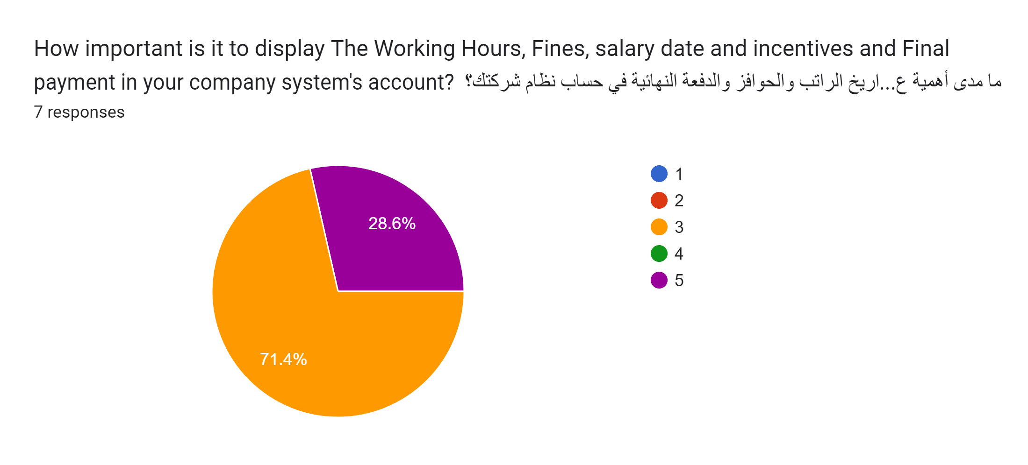
Lawyer: Q1
This functionality was faced with an overwhelming neutral response indicating that the lawyers don’t find it that important to track their finances.

Slide 26
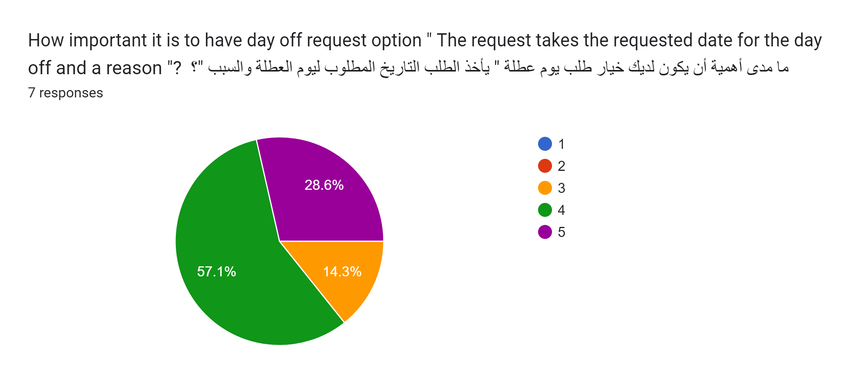
Lawyer: Q2
With most of the votes being positive. it indicates that the option to easily and remotely ask for a day off request is a quality-of-life option that most HR Employees desire as it removes the embarrassment of going to your superior and asking for a day off.

Slide 27
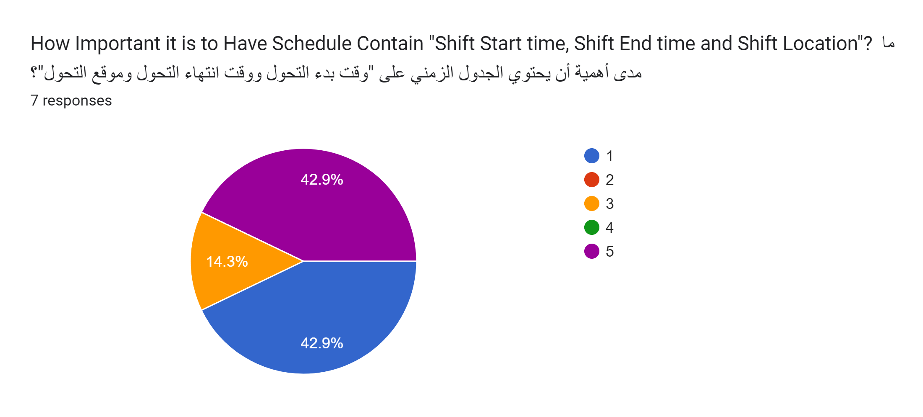
Lawyer: Q3
The vote is split in a 50% - 50% positive and negative indicating that depending on the person the functionality could either be extremely useful or useless. Useless probably due to the fact the the lawyers wont be constraint to a schedule or to a specific location.

Slide 28
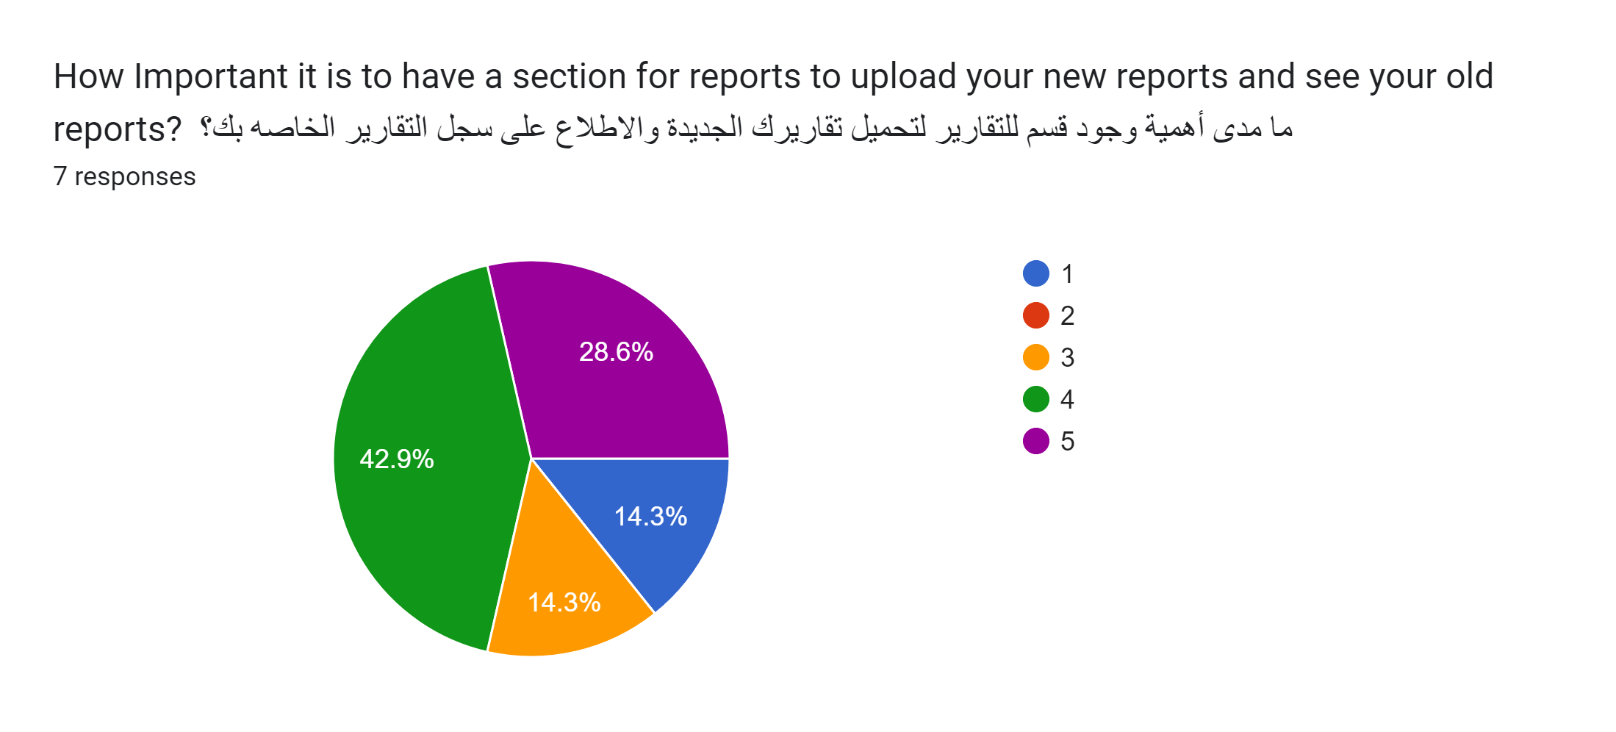
Lawyer: Q4
With most people in favor of this feature it seams that there are some who are not in favor of it probably due to their skepticisms of the security of the data due to its importance.

Slide 29
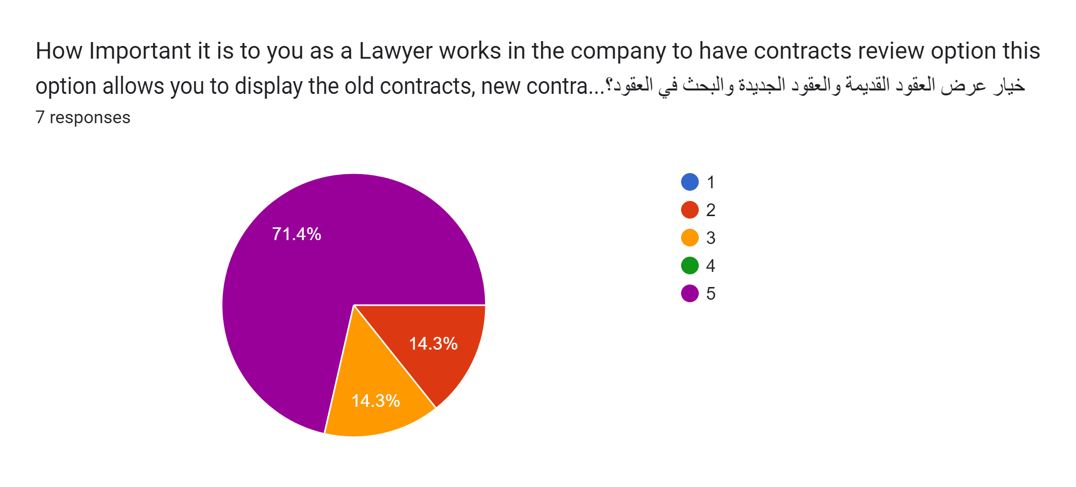
Lawyer: Q5
With an overwhelmingly positive response probably because this function would make their job easier it is an important function.

Slide 30
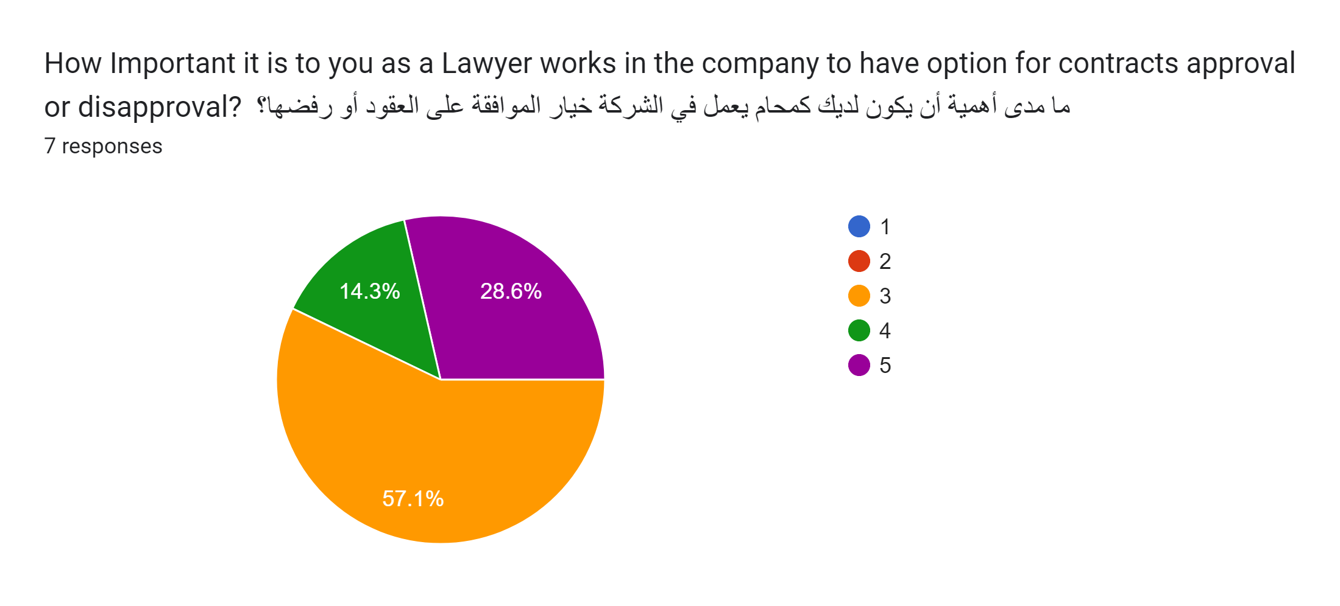
Lawyer: Q6
With an overwhelmingly neutral response it seams that this functionality isn't needed since the approval and disapproval must be completed on paper.

Slide 31
Lawyer Survey Summary
In teem of the functionality related to the lawyer’s job they weren’t met with that much positivity as all of what they do must be do on real paper and cannot be completed in digital form. Excluding reviewing contracts as having a digital reliable copy of the contract at any time is extremely useful.
The quality-of-life features(Day off request option) were met with a positive outlook as it removed the embarrassment of the human interaction.
The time/financial management functionalities were met with an extremely neutral response.

Slide 32
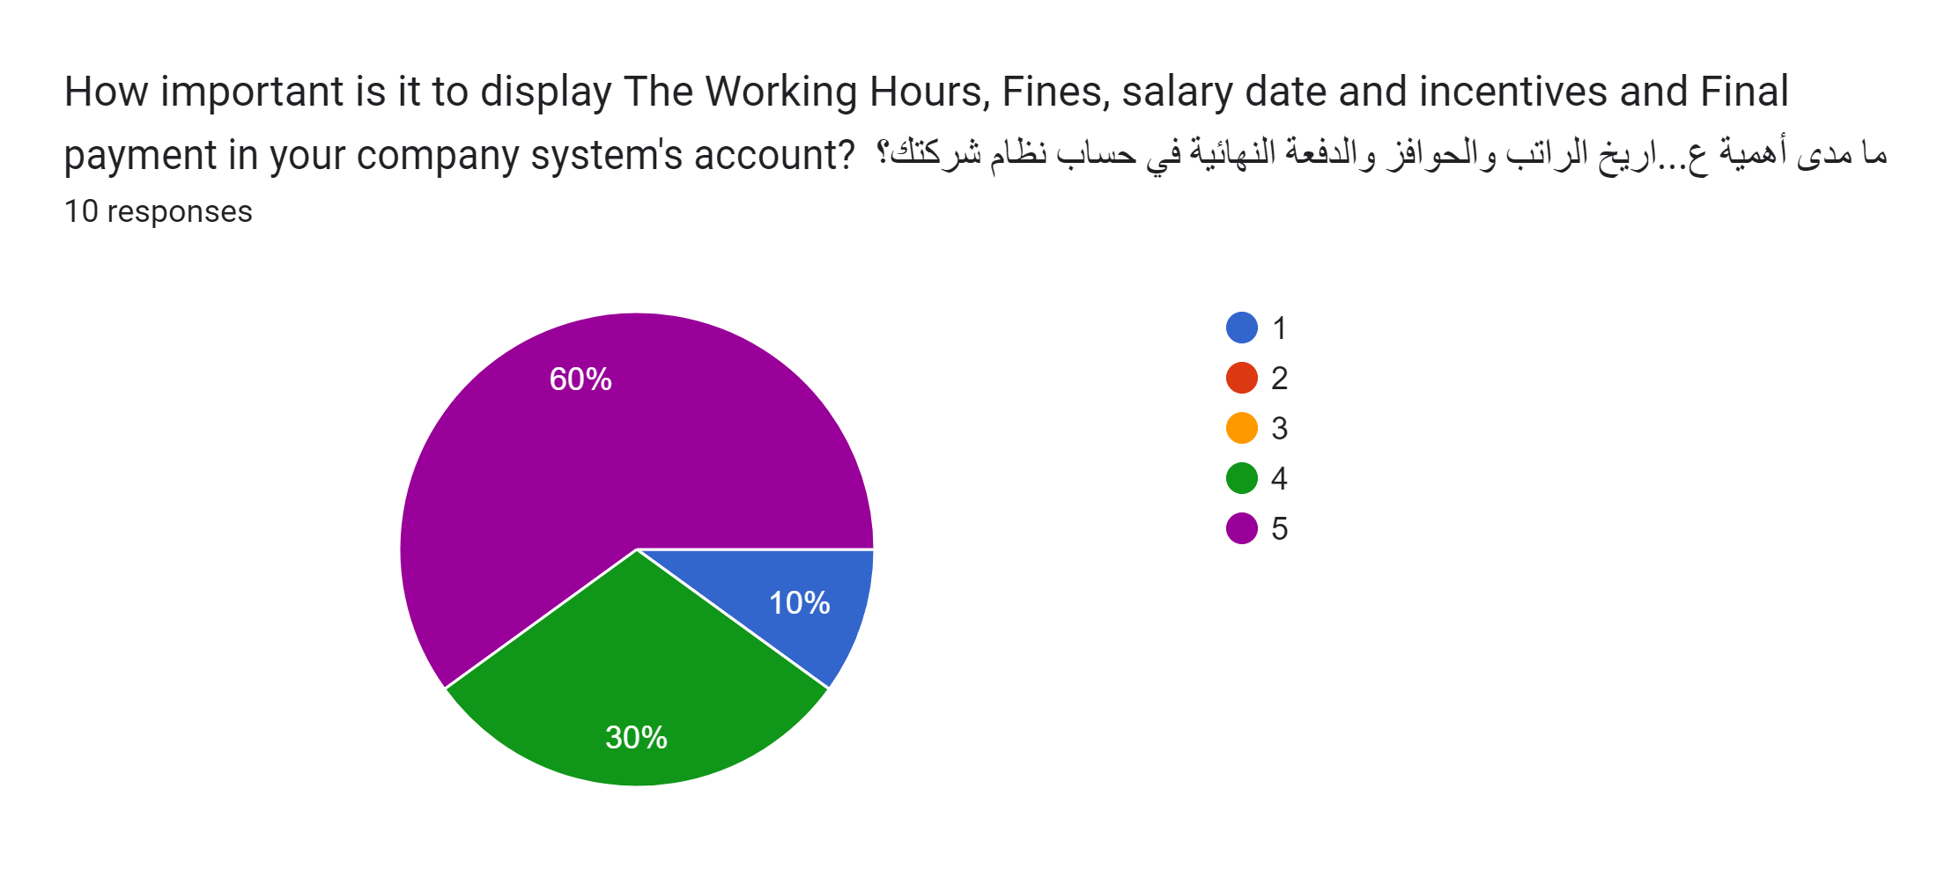
Worker: Q1
The extremely high positive review indicates the importance of this functionality as it helps workers track and manage their finances.

Slide 33
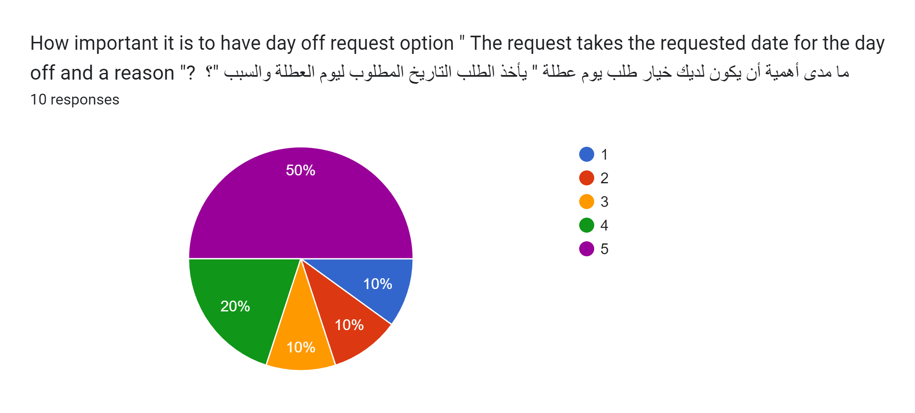
Worker: Q2
With the most common answer at 50% being 5. it indicates that the option to easily and remotely ask for a day off request is a quality-of-life option that most Workers desire as it removes the embarrassment of going to your superior and asking for a day off.

Slide 34
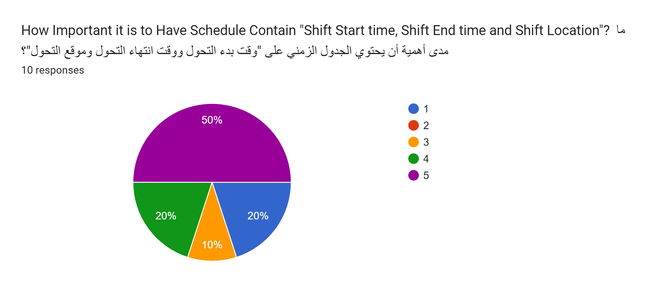
Worker: Q3
With an overwhelmingly positive response. it indicates the impotent of this feature as it is the main purpose of this system (Making it easier for the employees to track their Schedule).

Slide 35
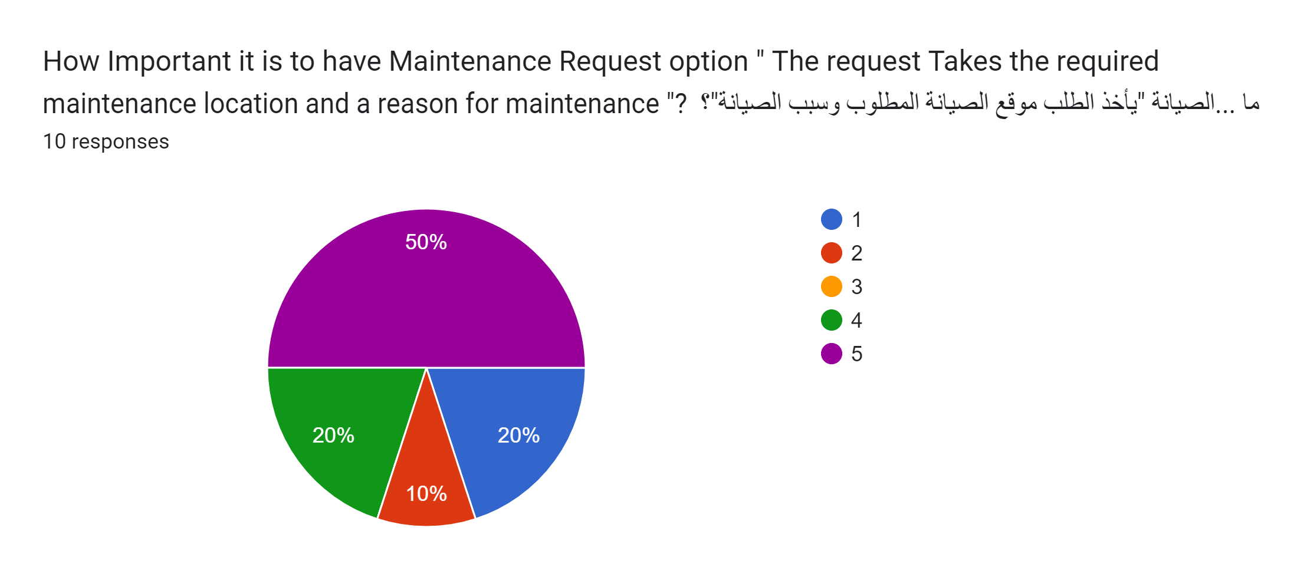
Worker: Q4
The extremely positive response for this functionality is to be expected as reporting the mechanical failure is one of the responsibilities of the worker working in the location of the failure.

Slide 36
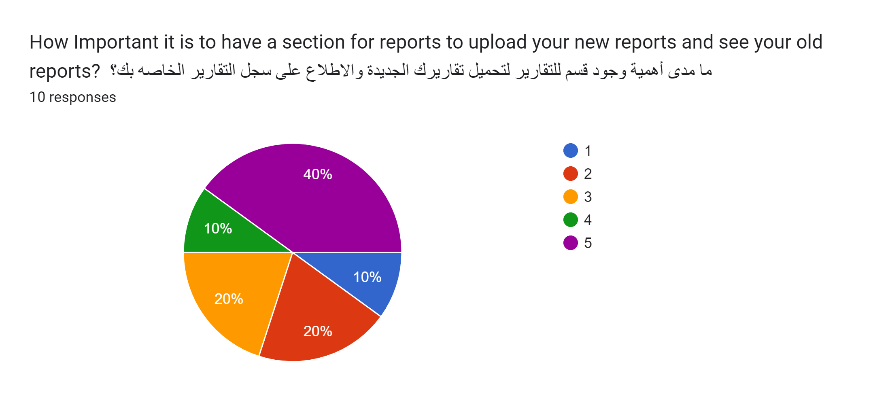
Worker: Q5
As much as the response is positive it is also negative and that is to be predicted seeing as the only workers who are going to use this functionalities are the heads of each group of workers

Slide 37
Worker Survey Summary
The Time/Finance management functionalities were met with an extremely positive response probably due to the importance of them for each worker seeing as the location, start, end time can change daily.
The quality-of-life features(Day off request option) were met with a positive outlook as it removed the embarrassment of the human interaction.
The work-related functionalities were met with mixed responses, where the maintained request option was met with positive responses while the report displaying/uploading was met with a mixed bag of responses.

Slide 38
End
This report includes a summarization of the responses to the functionalities offered for each professions in the company excluding lab technicians, security workers due to the lack of responses for both those professions.
Each profession has a summary summarizing the responses for each functionality.

